Slide 1
CICD Implementation
Team 21 Spring 2023
Updated: 6/7/2023

Slide 2
Branch Structure Strategy
Two fundamental branches
The main branch
Stores current stable release*
*The main branch can slightly differ in repo-level things (e.g. CI/CD or README changes) – releases are kept safe via tags (e.g., our v0.1.0 is unchanged regardless of what happens to main)
Push from dev branch (via pull request) to make a new release
Create an offshoot branch from main and make a pull request to merge back into main for repo-level things
E.g., CI/CD or README changes
May depend on case-by-case basis (for small changes we just want to commit once without a big headache)
The dev branch
Collective branch for everyone to work on next release
Feature / bug-fix branches come from the dev branch and are merged back via pull-request to add new features / bug fixes to development work

Slide 3
CI / CD Approach
Three unique situations:
Pushing to the main branch
Linting, tests, main branch docs, minimization, deployment
Pushing to the dev branch
Linting, tests, dev branch docs (stored in a separate folder than main branch docs)
Pushing to other branches / creating a pull request
Linting and tests
Each situation has its own workflow (three .yml files)
Could add more steps / workflows in the future if necessary

Slide 4
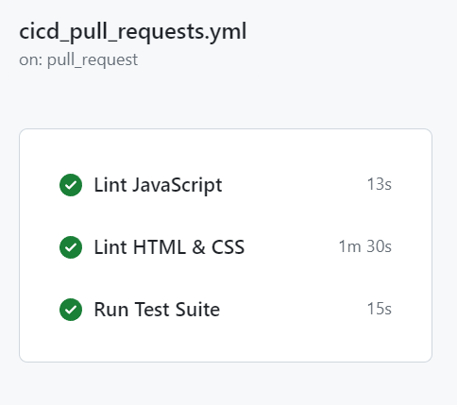
Pushing to other branches / Pull Requests

Slide 5
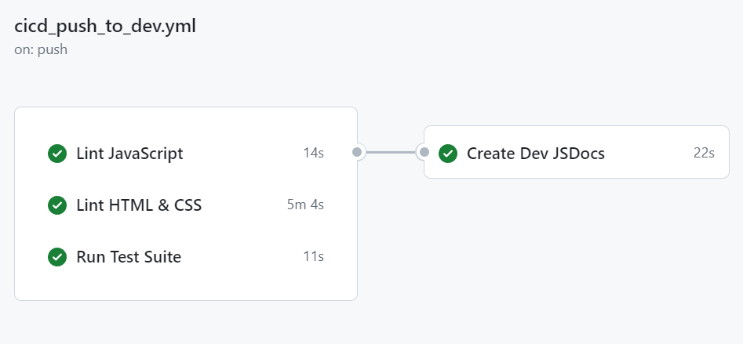
Pushing to dev branch

Slide 6
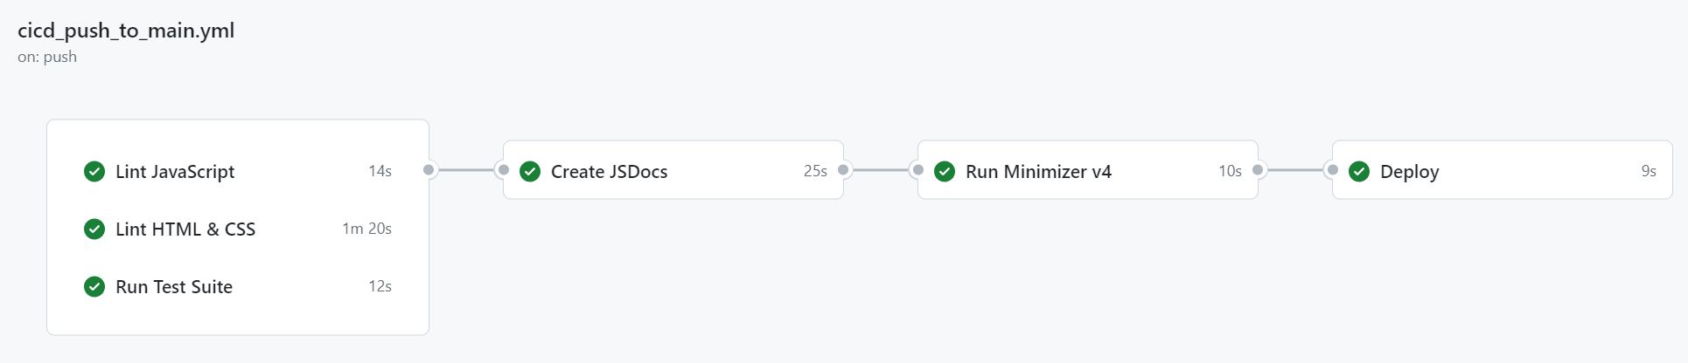
Pushing to main branch

Slide 7
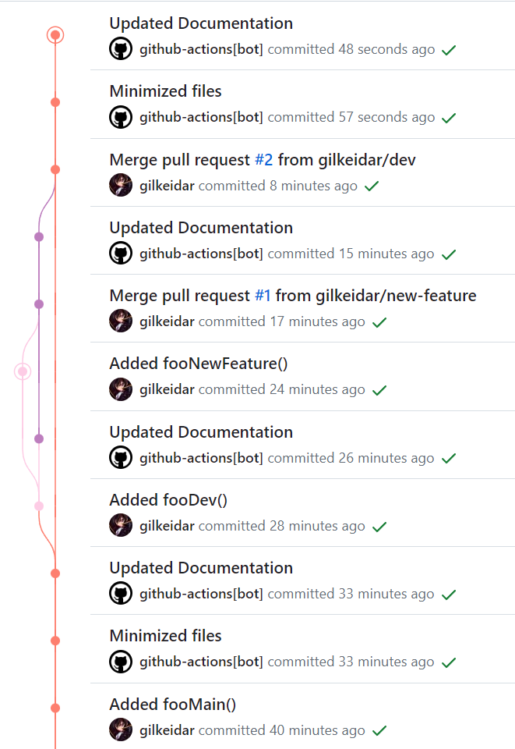

Visualized Commit Work
Push to main: Added fooMain() – triggers push to main workflow
Workflow creates documentation in the docs/ directory and generates minimized code in the dist/ directory (in two separate commits)
Push to dev: Added fooDev() – triggers push to dev workflow
Workflow creates documentation in the dev-docs/ directory
this is done to avoid merge conflicts
dev-docs is deleted from the main branch upon merging dev with main to create a new release
Push to new-feature: Added fooNewFeature() – triggers pull request or general push workflow
Lints JavaScript / HTML / CSS and runs test suite, but that’s it
Pull request from new-feature to dev: Triggers pull request or general push workflow
After the pull request is merged to dev, the push to dev workflow will be run since we’re pushing to dev
Pull request from dev to main: Triggers pull request or general push workflow
After the pull request is merged to main, the push to main workflow will be run since we’re pushing to main

Slide 8
Visualized Commit Work
Push to main: Added fooMain() – triggers push to main workflow
Workflow creates documentation in the docs/ directory and generates minimized code in the dist/ directory (in two separate commits)
Push to dev: Added fooDev() – triggers push to dev workflow
Workflow creates documentation in the dev-docs/ directory
this is done to avoid merge conflicts
dev-docs is deleted from the main branch upon merging dev with main to create a new release
Push to new-feature: Added fooNewFeature() – triggers pull request or general push workflow
Lints JavaScript / HTML / CSS and runs test suite, but that’s it
Pull request from new-feature to dev: Triggers pull request or general push workflow
After the pull request is merged to dev, the push to dev workflow will be run since we’re pushing to dev
Pull request from dev to main: Triggers pull request or general push workflow
After the pull request is merged to main, the push to main workflow will be run since we’re pushing to main

Slide 9
CI / CD Current Steps

Slide 10

Linting - JavaScript
Linter is used to maintain code style throughout our project
JavaScript Linter – Semi-Standard Style
Allows for semi-colons (important for minifier)
Recommended: Install the Standard Style VSCode Extension
Found here
After installing, go to Extensions > StandardJS – JavaScript Standard Style > Extension Settings and set Standard: Engine to semistandard.
To check that it worked, open a JavaScript file. If the code isn’t in Semi-Standard style, you’ll see lots of red squiggly underlines. Save the file and it should update the code to conform to this style (you may need to save multiple times)

Slide 11

Linting – HTML & CSS
Linter is used to maintain code style throughout our project
HTML & CSS Linter – Super-Linter
Found here
Advantages:
Easy to use – it’s a GitHub Action
Supports lots of languages
Disadvantages:
Slow install time – you can expect it to run for at least 1 minute which slows down the CI/CD pipeline considerably

Slide 12

Testing - Jest
Testing JavaScript files with Jest
Install Jest in the terminal using
npm install --save-dev jest
Alternatively, the repository’s package.json and package-lock.json files already specify the required dependencies, so I believe that you can just pull from the repository and then run npm install instead.
Put your tests in a tests/ folder outside src/
Note that at present the JavaScript linter does lint the tests folder. If this causes issues, it can be easily configured to not lint the tests folder.

Slide 13
Documentation - JSDocs
Generates a documentation website (no deployment, however) automatically when you push to dev or to main
The docs generated for the dev branch and the docs generated for the main branch are stored in separate folders.
Can easily configure the template for the documentation website (i.e. its appearance – see here)
To use, use /** JSDoc comment */ in your code (above classes, functions, and variables)
Recommended: use tags and specify the types of parameters:
/**
* Creates a FortuneEngine object.
* @param {string} app_name that gives name of fortune teller type
*/

Slide 14
Minimization – UglifyJS + HTML Minifier
Minimization makes the distributed code smaller by removing whitespace and shortening variable names
Minifies files in src/ and puts the minified versions in dist/
Code (HTML, CSS, JS) gets minified and put in dist/
All other files (e.g. JSON, pictures, sound files, etc.) simply get copied
All relevant files MUST be in src folder
That means that we need to move the assets/ folder into the src/ folder!
Only gets run when pushing to main
Originally run with a GitHub Action – now, it is accomplished via running a shell script (minimize.sh) stored in the .github/ directory

Slide 15

Deployment – GitHub Pages
Deployment hosts our code from the dist/ directory onto GitHub Pages
This is the last step (after minimization) of the push to main workflow
Deploys whatever is in the dist/ directory onto a GitHub Page
It does this by pushing the contents of the dist/ directory to the gh-pages branch
GitHub then runs its own workflow to deploy the contents of the gh-pages branch to https://cse110-sp23-group21.github.io/map-my-future/

Slide 16
Let’s take a look at the .yml files

